Slide 1

CROWDFUNDING ANALYSIS PROJECT
Presenter : Group 3
Mr. Praduman Pandey
Mrs. Pooja Raikar
Mr. Akshay Khade
Mr. Shreyash Choraghe
Mr. Vaibhav Patil
Mr. Shivam Jawale
Mr. Ruturaj kolhar

Slide 2
INTRODUCTION
A crowdsourcing tool that facilitates the creation of funds for artistic projects.
MAIN ROLES
Product creators: They launch a campaign to determine how successful a new product will be before investing in manufacture.
Backers: Make a commitment to buy a product before it launches to encourage the development of innovative, new products.
FUNDING
Product Creators: The creators establish a financing target and a timeline for achieving it.
Backers: They will only be charged if the creator fulfills their funding goal and duration.
OUTCOME
Both the creator and the backer benefit from it. The creator will know how much products has to be ordered and created if the campaign is successful.
The backers don't lose anything if the campaign doesn't receive funding.

Slide 3
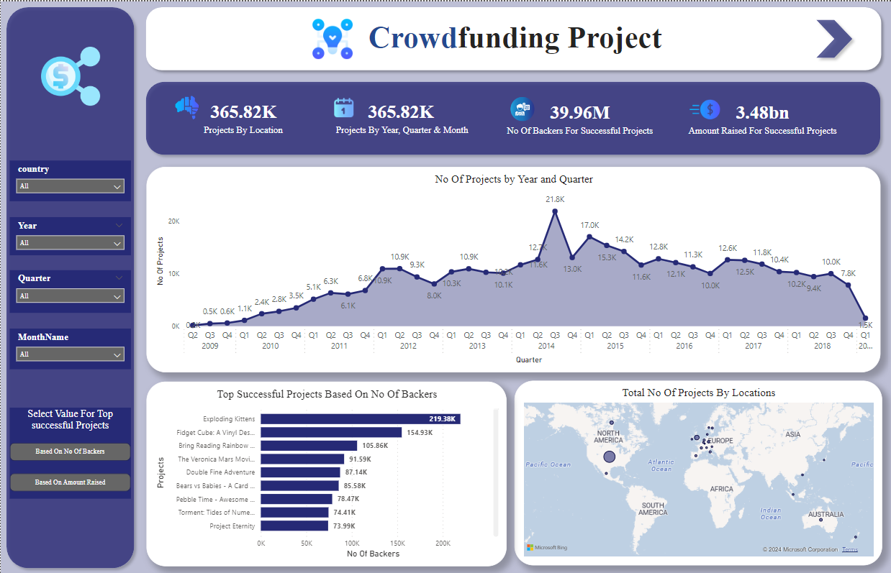

Slide 4
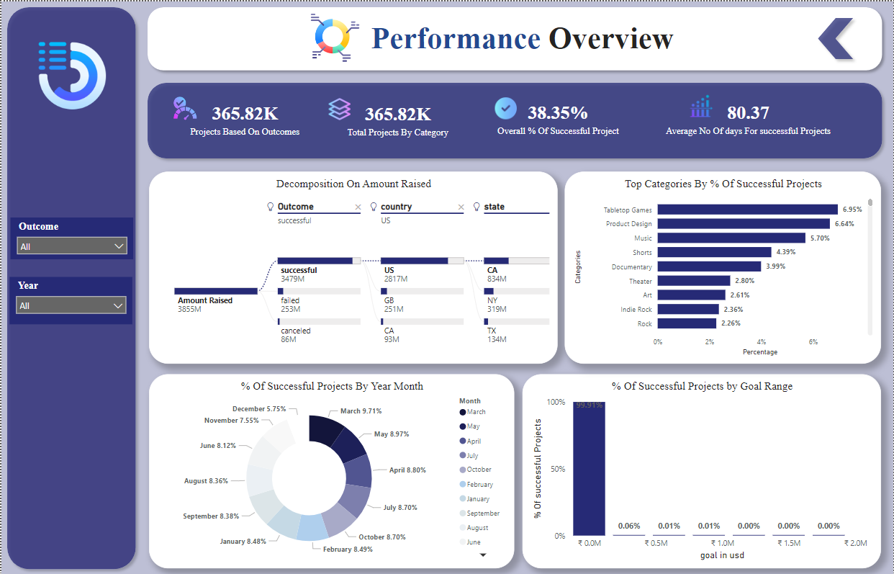

Slide 5

ANALYSIS
188,239 projects marked as failed and 140,313 projects recorded as successful, there's a notable disparity in outcomes.
178 projects have been purged, while 3,163 projects are currently live and actively progressing.
Cancellation of 32,498 projects underscores challenges in project management and resource allocation.
In total, there are 365,892 projects captured across all states, reflecting a diverse landscape of project outcomes and highlighting the importance of effective project monitoring and evaluation.
At 2,78,485, US had the highest projects and was higher than LU, which had the lowest no.of projects that is 68.﻿
Based on total no of backers we have exploding kittens with highest that is 219K as well as based on amount raised we have pebble time smartwatch with highest amount that is 20M
In the year 2009, there were only 1.31K projects, which have increased year on year and By 2019, there was a drastic drop to only 1.52K projects.
Initial Struggles (2009): The journey began with a low success rate of only 0.41%, highlighting initial challenges and learning curves.
Decline in Success (2019): Faced a steep decline to just 0.03%, necessitating an analysis of underlying issues and challenges.
Rapid Growth (2014): Achieved a peak success rate of 13.73%, showcasing effective strategies and improved execution.
By percentage of successful projects based on category we have Tabletop games, Product design, Music has highest success rate.
Most of the successful projects lies in the Goal range between [0 – 500000] which is about 99%.

Slide 6

SUGGESTION
It's essential to carefully plan and allocate resources effectively to ensure the success of projects. Implementing robust project management methodologies and tools can help streamline processes and mitigate risks.
Analyzing past trends, such as the drastic drop in projects in 2019, can provide valuable insights into underlying issues and challenges. Understanding why certain trends occur can help in developing strategies to address them and prevent similar issues in the future.
Identifying categories with the highest success rates, such as Tabletop games, Product design, and Music, can offer valuable lessons for other project categories. Analyzing successful projects within these categories can help identify best practices and strategies that can be applied to other projects.
Since most successful projects fall within the goal range of [0 – 500,000], it's important to set realistic goals and develop effective funding strategies. This may involve conducting thorough market research, building a strong network of backers, and leveraging various crowdfunding platforms effectively.

Slide 7

CONCLUSION
Finally, it's essential to adopt a mindset of continuous improvement. Regularly reviewing and refining project management processes, learning from both successes and failures, and staying adaptable in the face of changing circumstances can help ensure long-term success.
The average success rate for projects is 38.35% and only categories above this rate should be considered to maximize the possibility of success. By focusing on these areas and implementing appropriate strategies, you can work towards overcoming challenges and improving project outcomes.

Slide 8

Thank You

